Slide 1
Good Afternoon
And welcome to our presentation!
By: Fadi Salback & Sarthak Sharma

Slide 2

MeMusic

Slide 3
MeMusic - unique features
-A music streaming app that is customer and artist friendly!
-Any artist no matter how big or small is able to upload his music to our app.
-Customers will be able to stream any new or old music in real time!
-Offers any genre of music.
-Customers with subscription are able to save music to listen to offline.
-Users are able to share, rate, and comment on their favourite songs & artists

Slide 4
Problems To Beat.
-Our motivation in creating MeMusic is to build a platform where artists feel comfortable to stream their music on our application. A lot of companies are unfair to artists who are not as famous. They take advantage of them, if one of their songs become very popular on the platform and won't give them the same money as the big names.
-MeMusic does not care how popular an artist is all that is important is how many listeners they attract per month
-NO CONTRACTS.. Only an initial fee to register as a client a second fee for each song or a discounted price for albums that they choose to publish on our music hub
-Of course royalties will be paid directly to the client based on how many listeners he achieves per month.

Slide 5
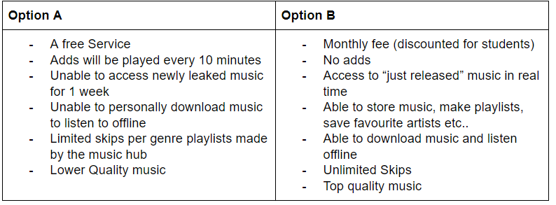
Customer features

Slide 6
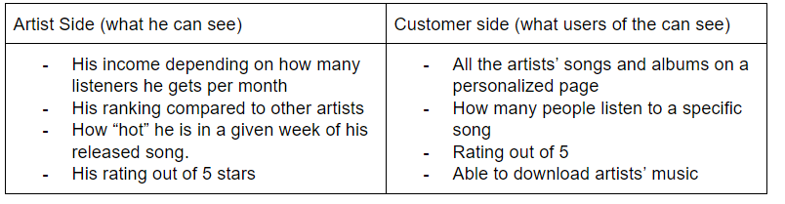
Artist features

Slide 7
Objectives and measure of success
-Keeping track of major activities on our app such as searches, downloads, likes, numbers of listeners etc.. will help us better understand how users like to navigate around our application.
-Ensuring fairness to all artists, Upload charge won't be too expensive
-Non- premium accounts will have ad-streaming which will help maintain revenue
-Internationally available to customers and artists ensuring that it is not too expensive for counties with a comparatively lower economy than Canada
-With competition so high from other music apps versatility is important to attract all people by adding small sections for renowned international songs and artists.

Slide 8
Risks
-Estimation and Scheduling does not go as planned.
-Suddenly requirements become much bigger.
-Productivity issues.
-Important employees may take vacation days or become sick.
-Product may go unnoticed in the market in the beginning due to lack of advertising.
-Competitive market.
-Miscommunication may lead to wrong implementations of our design.
-System failures may require a whole new procedure.

Slide 9
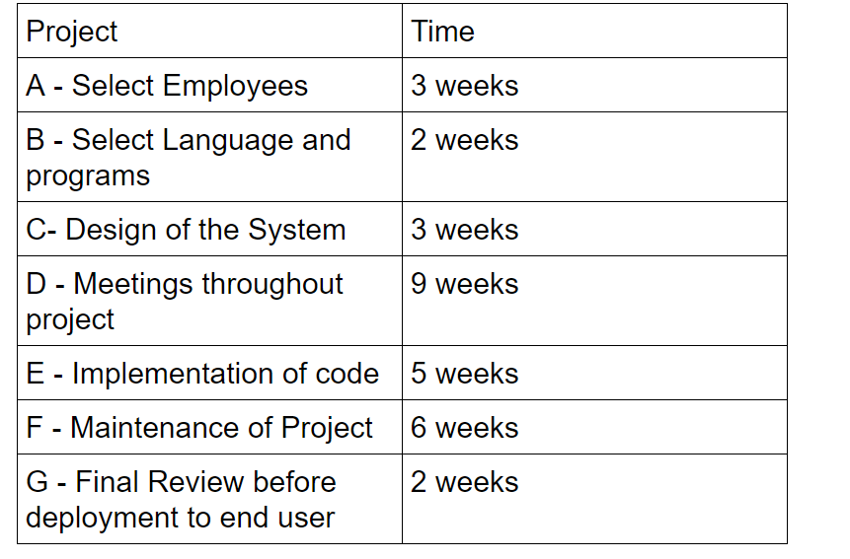
Projects & Time to complete

Slide 10
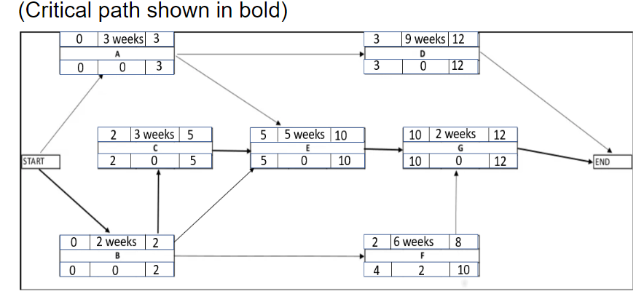
Activity diagram
The critical path is the sequence of the project activities which take the longest duration to complete.

Slide 11
Infrastructure
-Does not require much hardware or various softwares
-A user-friendly application that runs on various operating systems (smart phones, computers)
-A cloud server which is the most important component because all data on music, artists and accounts will be stored into databases
-To be easily accessible with fast upload and download speed, encryption of sensitive user information such as passwords and banking information
-Maintaining security and integrity is a top priority so a secure service must be implemented to block any sorts of leaks or hackers.
-Will require BI/AI software to be continuously running to track activity on the app. Keep track of weekly, monthly and yearly stats.

Slide 12
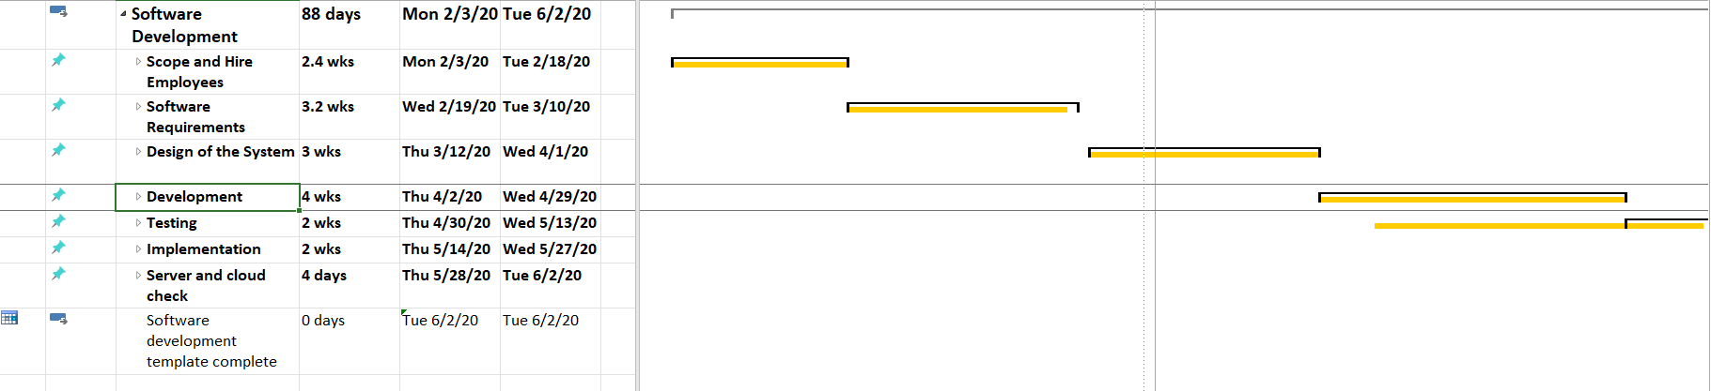
Gantt Chart

Slide 13
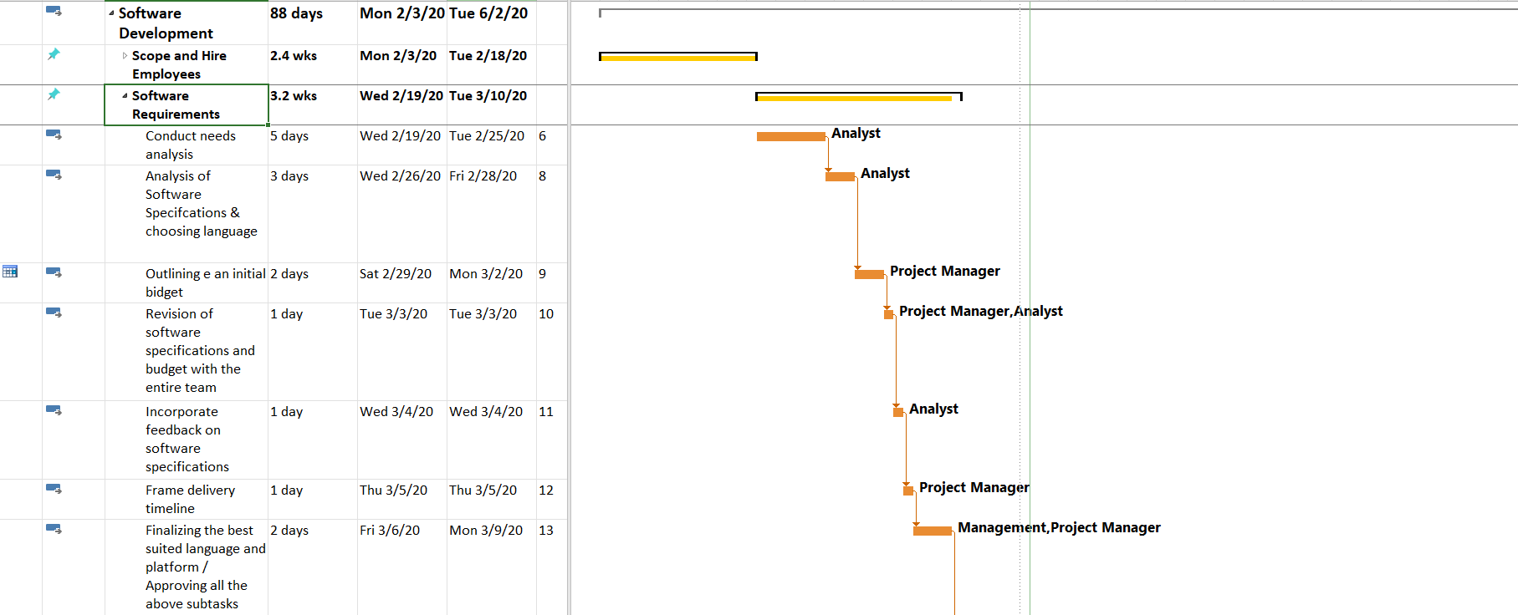
Gantt Chart Contd.

Slide 14
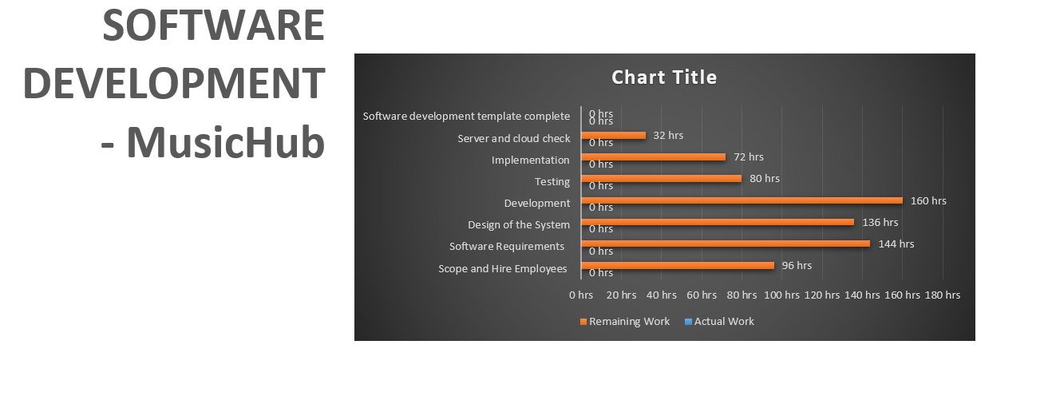
Summary of the Gantt Chart

Slide 15
Thank You For Your Time.
Questions??

